Slide 1
Target Model Info
 | # of Channel (C) | Size of input Width (W) | Size of input Height (W) | Size of Kernel (K) | # of Output features (M)
Conv. Layer 1 | 1 | 86 | 86 | 7*7 | 4
Conv. Layer 2 | 4 | 40 | 40 | 7*7 | 16

Slide 2
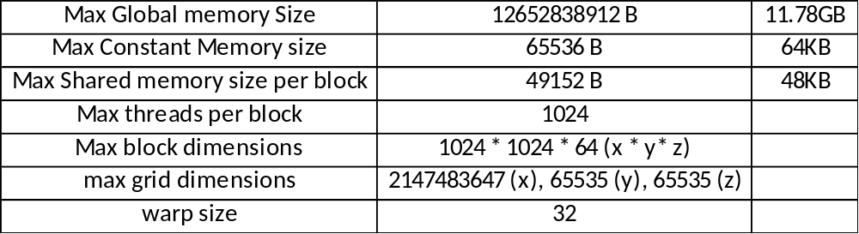
GPU Information (TITAN V, compute cap.: 7.0)

